Slide 1
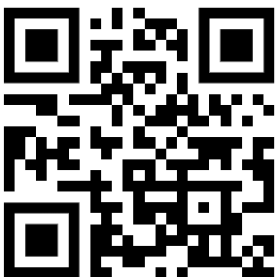
Deep Dive Beyond Basics
Dr. Damir Dobric
Lead Software Architect daenet GmbH / ACP Digital
Microsoft Regional Director,
Most Valuable Professional: Azure+AI

Slide 2
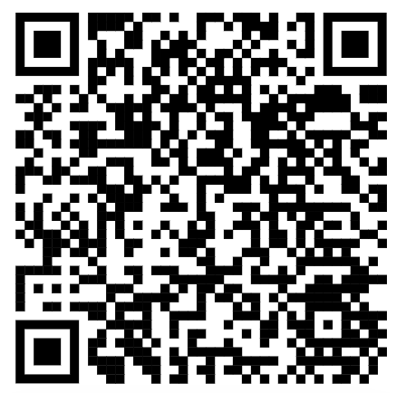
See github repo
https://github.com/ddobric/semantic-kernel-training
https://tinyurl.com/49tf9346

Slide 3
AGENDA
Tokens
Embeddings
Completions
Agents in Microsoft Agent Framework
Agents and Foundry
Natural Language to T-SQL

Slide 4
TOKENS

Slide 5
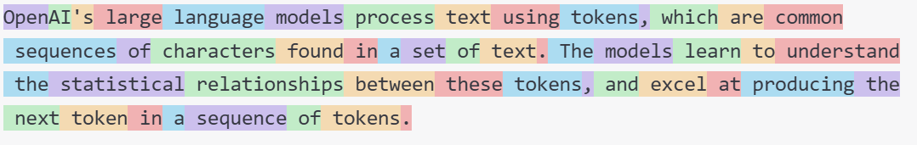
What are tokens?
1 token ~= 4 chars in English
1 token ~= ¾ words
100 tokens ~= 75 words
Byte Pare Encoding (Gage,1994): Wikipedia
What are tokens and how to count them?
Token Pricing: Pricing (openai.com)

Slide 6
Working with Tokens
Tokenizer
Creating tokens in C#
.\src\SKTrainingSolution\semantickernelsample: WorkingWithTokens

Slide 7
EMBEDDINGS

Slide 8
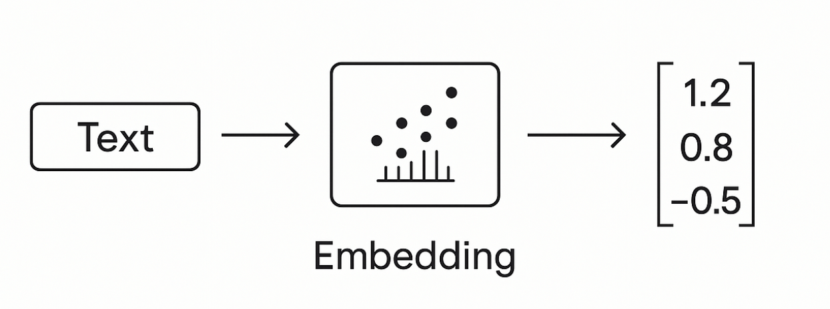
What is embedding Vector?

Slide 9
Embedding Models
Guess, today is a nice day in Palma
Today is a typical German rainy day
Two things are infinite: the universe and human stupidity; and I'm not sure about the universe.

Slide 10
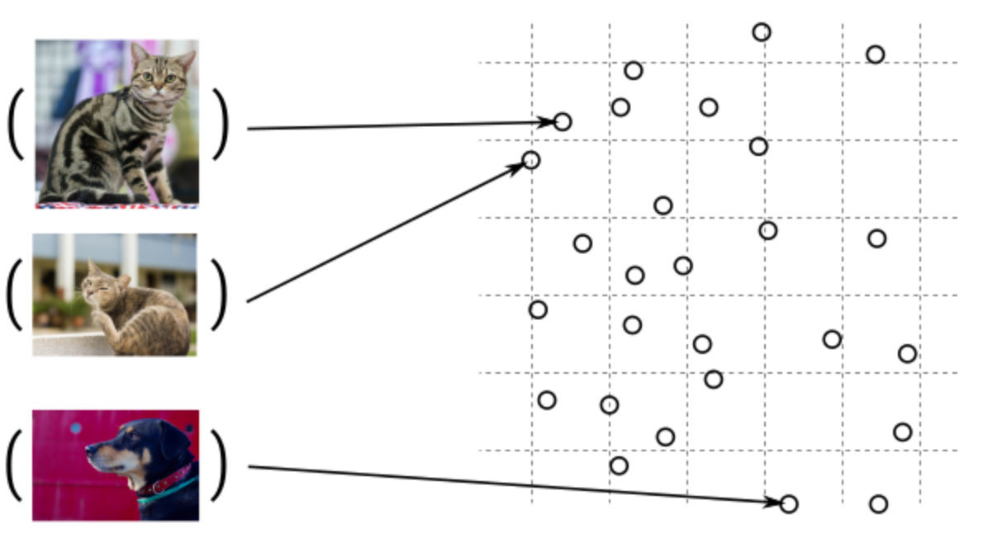
Embedding Models

Slide 11

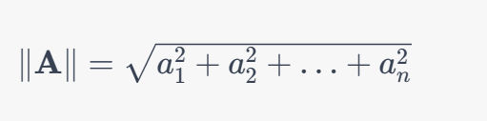

The Cosine Similarity
Dot Product
The Norm
Cosine Similarity

Slide 12
DEMO
Consuming Embedding Model with HTTP/Post
Creating Embeddings in C#
Semantic Similarity
.\src\OpenAI.Samples\Program.cs Sample: CreateEmbeddingsAsync()
.\src\OpenAI.Samples

Slide 13
When to use embeddings?
Semantic Search
Classification
Clustering
Recommendations
. . .

Slide 14
COMPLETIONS

Slide 15
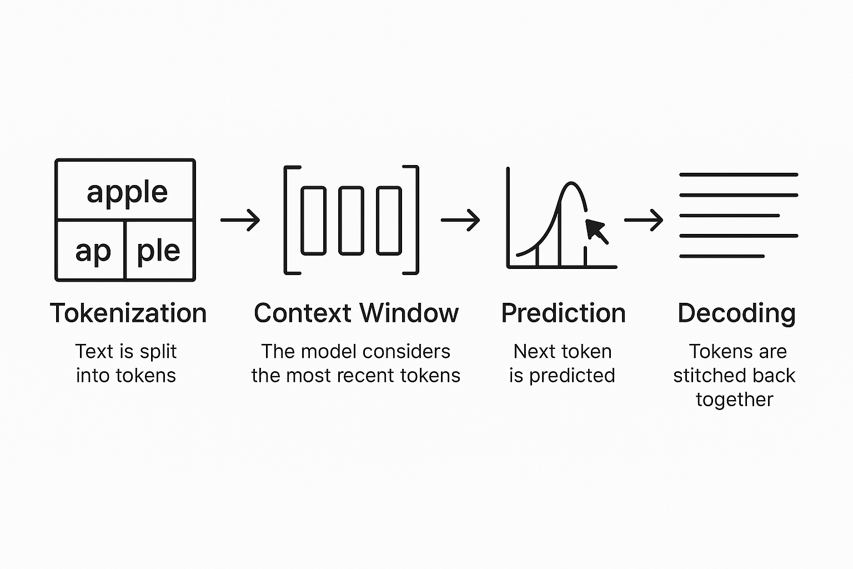
LLMs Complete Text

Slide 16
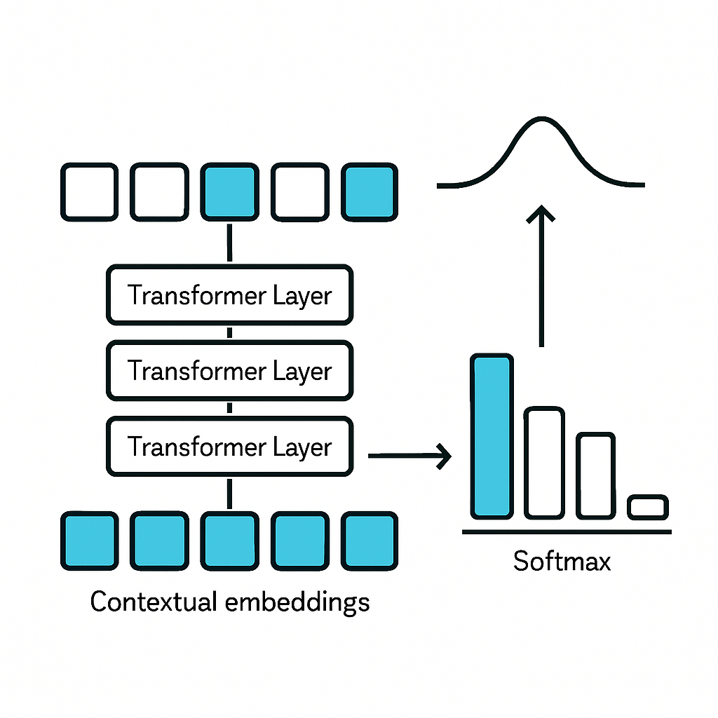
Transformers

Slide 17
Completing Text Under the hub
C# Application
Using OpenAI nuget package
Executing ChatCompletions
Presenting Probabilities
.\src\OpenAI.Samples Sample: ChatCompletionsAsync

Slide 18
Retrieval Augmented Generation R A G

Slide 19
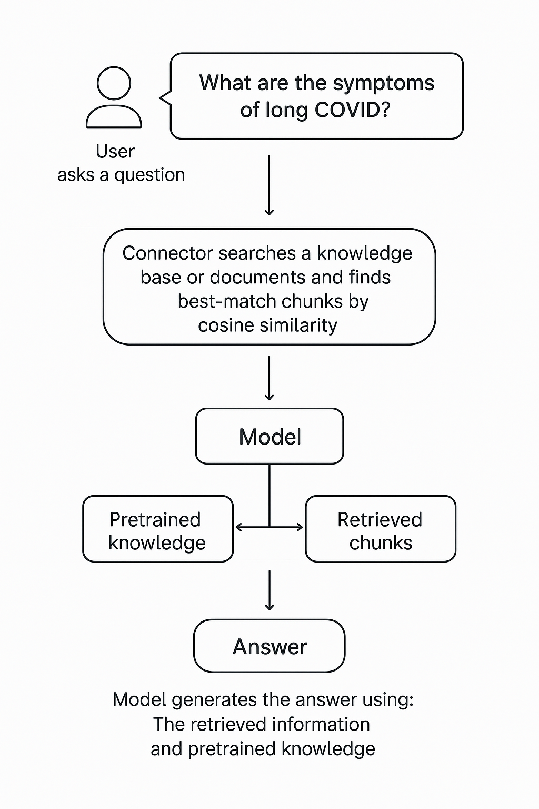
What is RAG?
Extending the model knowledge
Combines information retrieval with text generation
https://arxiv.org/abs/2005.11401

Slide 20
RAG Demos
Creating chunks
Creating embeddings
InMemory Vector DB
Calculating Similarity
.\src\SKTrainingSolution\semantickernelsample\ Samples: RagSample.cs

Slide 21
The problem with RAG
In a typical RAG pipeline:
You convert a query into an embedding
You search a vector database for similar embeddings
You retrieve the top k chunks (e.g., top 5 or 10)
The issue: 👉 Embedding similarity ≠ true relevance
Why?
Embeddings capture semantic similarity, not exact intent
They can miss nuance (negation, context, specificity)
You often get “kind of related” chunks instead of “exactly what you need”

Slide 22
Reranking
Reranking = a second, smarter filtering step
After retrieval:
You take the top k candidates (e.g., 20 chunks)
You pass them—together with the query—into a reranker model
The model scores each chunk based on actual relevance to the query
You keep the best n (e.g., top 3–5)
Score how relevant this document is to the query from 3-5

Slide 23
RAG Demo
RAG Agent with context
.\src\Agents\RagAgent

Slide 24
AGENTS Microsoft Agent Framework

Slide 25
MAF Demos
Foundry Agents
Hosted Agents
Simple Agent
Session
src\Agents\AgentFrameworkSamples 1_HelloAgents RunAsync {Run with and without stream} RunMultiturnAsync

Slide 26
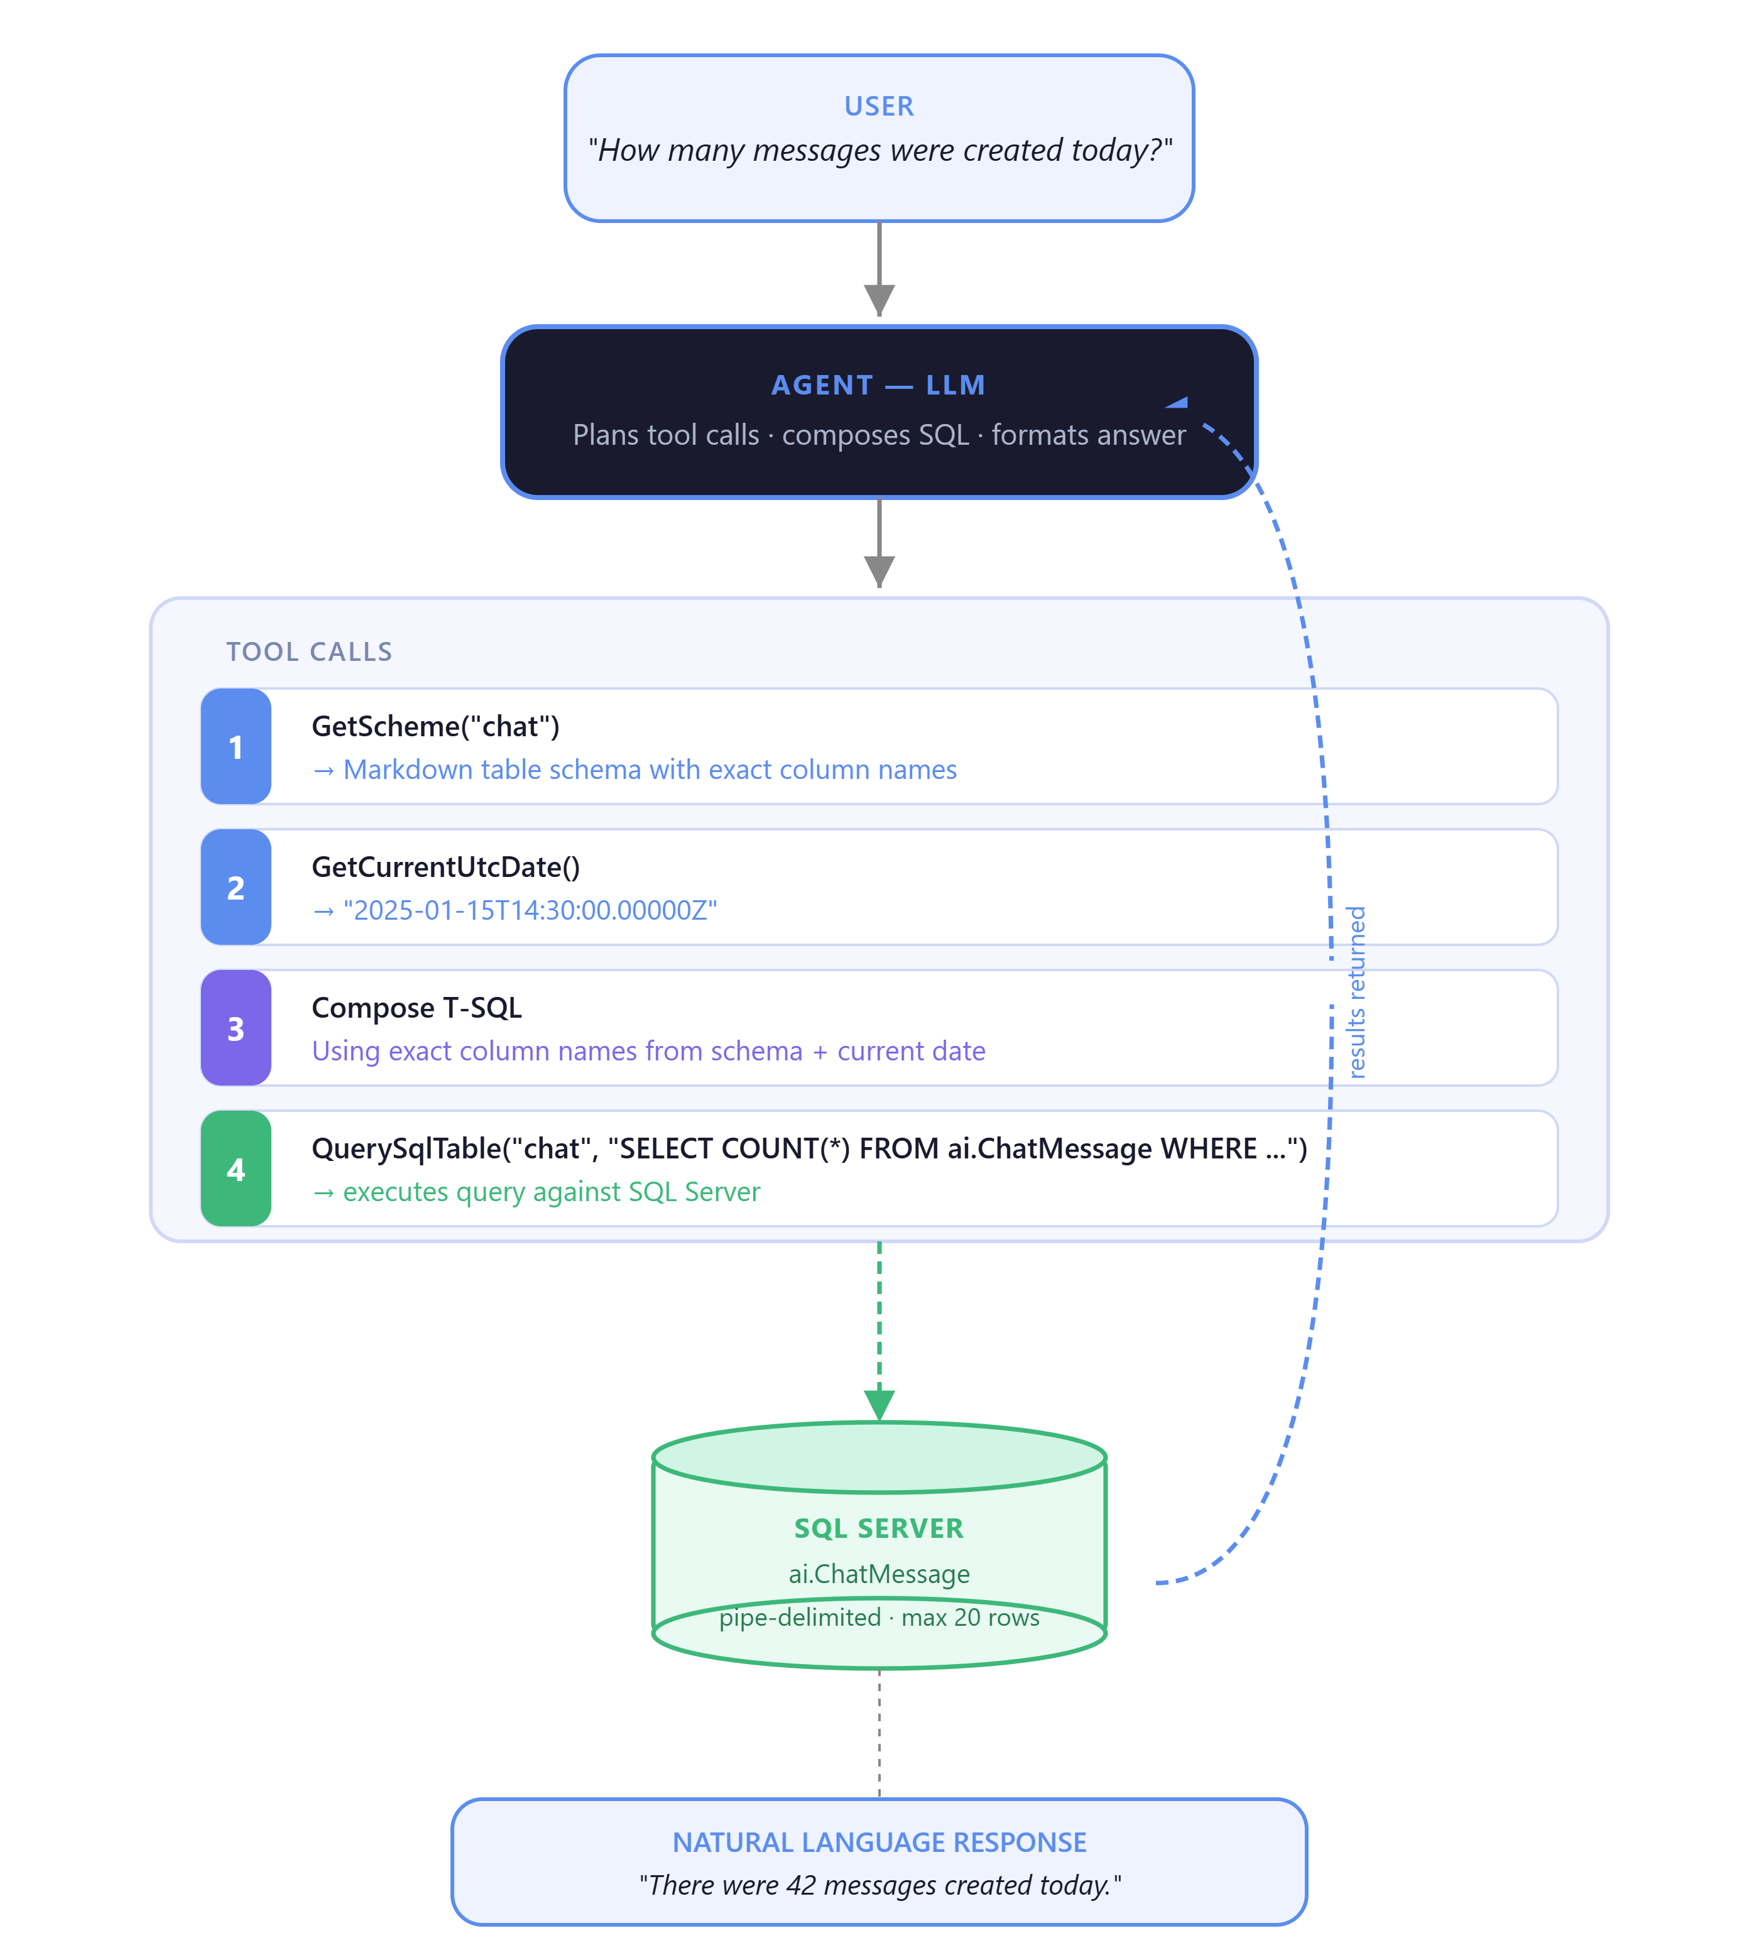
Demo
Natural Language to T-SQL
Query Relation DB via -> TDD-Driver

Slide 27
qatlho’neS ☺
Dr. Damir Dobric
Lead Software Architect daenet GmbH / ACP Digital
Microsoft Regional Director,
Most Valuable Professional: Azure + AI

